Slide 1
High-Energy Surveys in Astronomy
Richard Saxton
XMM SOC / ESAC, VEGA,
Madrid, Spain

Slide 2
Large Surveys
(100 eV – 100 GeV ≡ 10¹⁶-10²⁵ Hz)
(High Energy)
Construct large samples to understand the global properties of a class of sources
- AGN
- Clusters of galaxies
- Compact objects accreting from companions
- Stars
- Supernova Remnants
Find rare objects – filling in the details
  - Tidal Disruption events
  - Isolated neutron stars
  - Novae
  - Gamma-Ray Bursts (GRB)
  - Ultra-Luminous X-ray sources (ULX)
Notes:
Shares the same goals as all large area surveys- but with the speciality of seeing hot stuff – gases and plasmas with T>10^5 k

Slide 3
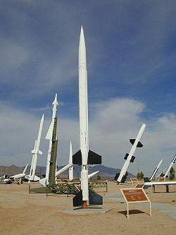
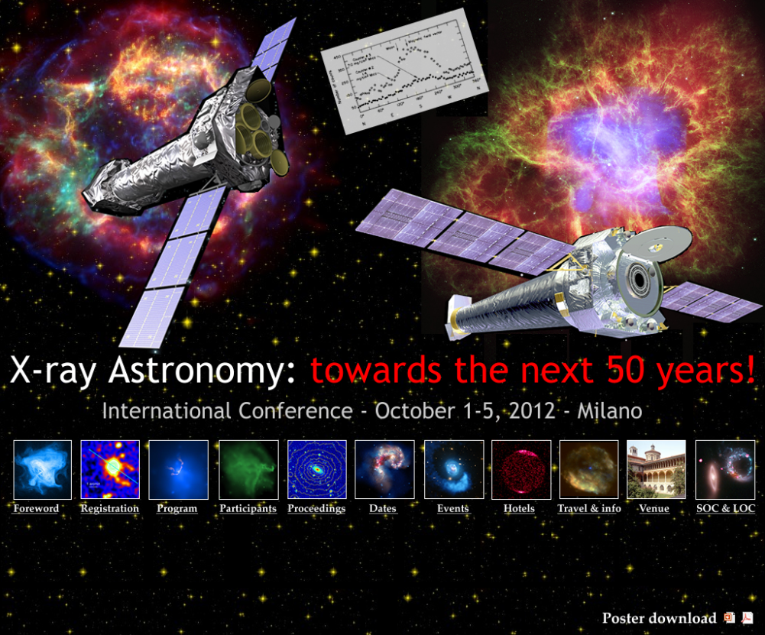
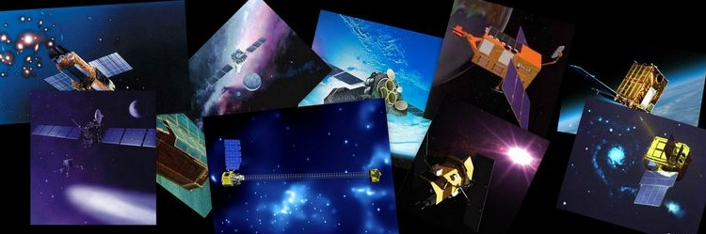
50 years of X-ray astronomy
June 12 1962 Riccardo Giacconi and the
AS&E group launched an X-ray experiment aboard an Aerobee 150 sounding rocket
Half a Century of X-ray Astronomy
Mykonos, Greece
September 17-21, 2012
Notes:
Thank organisers – fitting to give talk on 50th anniversary

Slide 4
Initial Discoveries
The AS&E experiment discovered two sources
of X-rays
1. Emission from a point above the Galactic plane – named as SCORPIUS X-1
2. Apparently uniform emission from everywhere which got the name of the cosmic X-ray background
Both of these discoveries were influential in shaping the goals of the missions to follow.
Notes:
Thank organisers – fitting to give talk on 50th anniversary

Slide 5
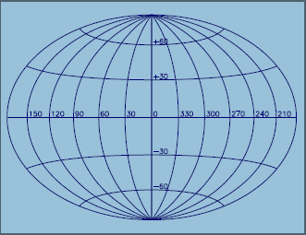
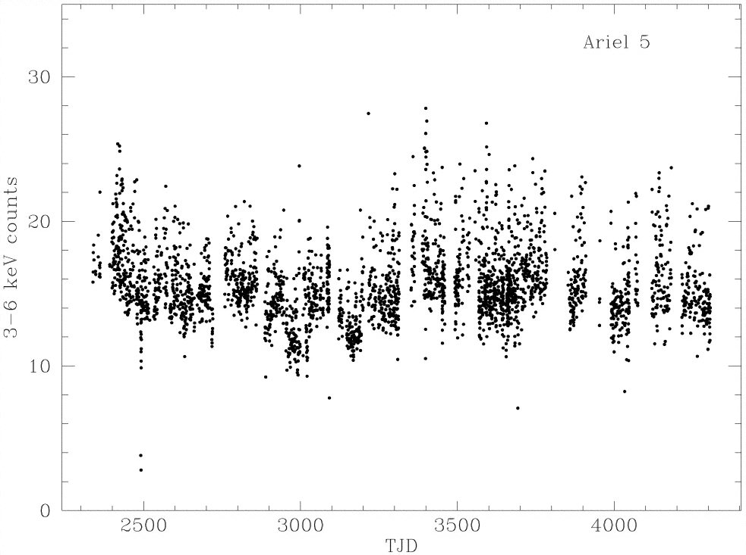
SCO X-1
SCO X-1 on a Galactic grid
Ariel-V light curve (3-6 keV)
Variability on all time scales down
to seconds.
Position refined with subsequent experiments and found to be coincident with
a 13th magnitude variable star at a distance of 9 kpc. The huge X-ray flux corresponds
to L_{x}=10³⁷ ergs/s
So much energy from a point just a few light seconds across gave theoretical problems
at first but was eventually realised to be emission from a binary system of a
neutron star accreting material from a stellar companion (Shklovski, 1967)

Slide 6
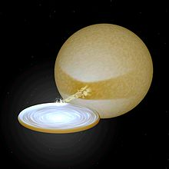
SCO X-1
SCO X-1 on a Galactic grid
Artist’s impression of a neutron star accreting from
a companion.
More examples were found and the source class given the name of
Low Mass X-ray binaries (LMXB). Now ~100 systems known.

Slide 7
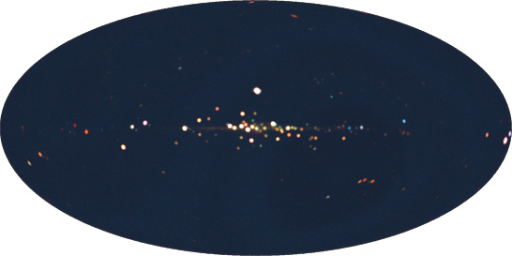
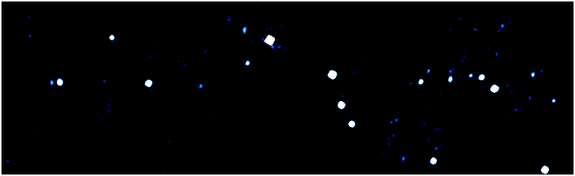
LMXB – high variability
INTEGRAL – view of the Galactic Plane – 30-50 keV
between 2003-01-29 and 2004-02-16
A. Bodaghee & R. Walter, ISDC, Geneva
Two orders of magnitude variability
in a few weeks.
MAXI – view of the Galactic Plane - first 10 months picture - 0.5 to 30 keV
Scans the sky every 96 minutes – ideal for finding bright transient sources
Notes:
End by: It took a while for the neutron star binary theory to be accepetd because it was thought that binaries would be disrupted during the supernova creation of the NS. On the other hand isolated neutron stars should be plentiful.

Slide 8
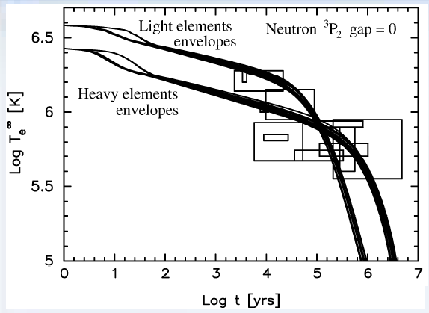
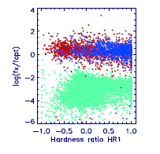
Isolated Neutron Stars
Page et al. 2004
ROSAT all-sky survey - Voges et al. 1999
These have thermal spectra which cool below the X-ray threshold after ~10^8 yrs.
While LMXB are brilliant , isolated neutron stars are intrinsically faint.
Can be recognised by a very soft X-ray spectrum and a very faint optical companion.
In the 100,000 source ROSAT all-sky survey catalogue only 7 examples were found.
These are nearby (100-500 pc) and young (30-50 Myr) with temperatures
of ~1million degs - 40-100 eV - all come from the Gould Belt - called the Magnificent Seven

Slide 9
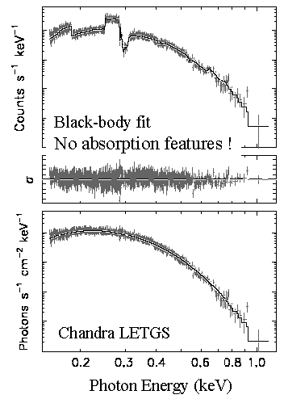
Isolated Neutron Stars
Burwitz et al. 2003
High-res spectrum of RXJ1856.5-3754
kT=63.5 eV
Generally well modelled by a pure thermal spectrum
even in high resolution X-ray spectra.

Slide 10

Cosmic X-ray background (CXB)
Initially there were two theories for the origin of the CXB
A thin uniform hot plasma filling the universe, supported by the isotropy and the
spectrum of the CXB reported by early experiments (Ariel-V, Uhuru, Heao-1)
Discarded when it was realised that this would introduce anisotropies in the
Cosmic Microwave Background which weren’t seen (Fabian & Barcons 1992,
Fixsen et al. 1996)

Slide 11
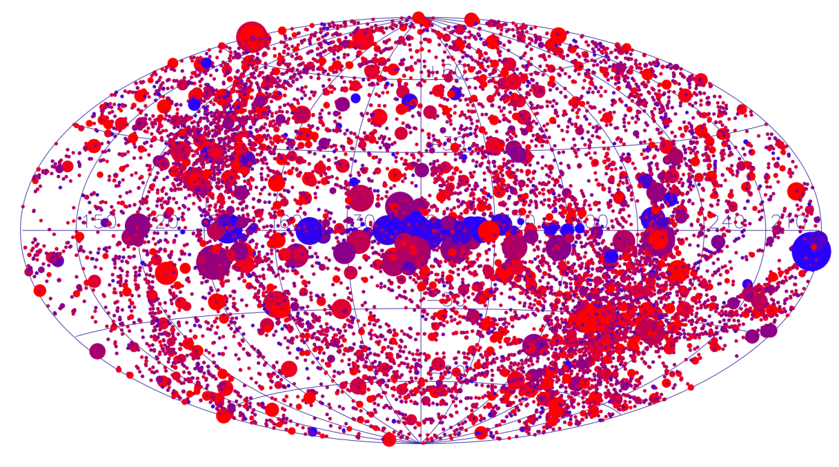
CXB – point sources
- A large number of isotropically distributed point sources
From the XMM-Newton slew survey : red = 0.1-2 keV, blue= 2-10 keV, size=log(flux)
The goal then became trying to identify these sources and later using them to
investigate the evolution of galaxies.

Slide 12
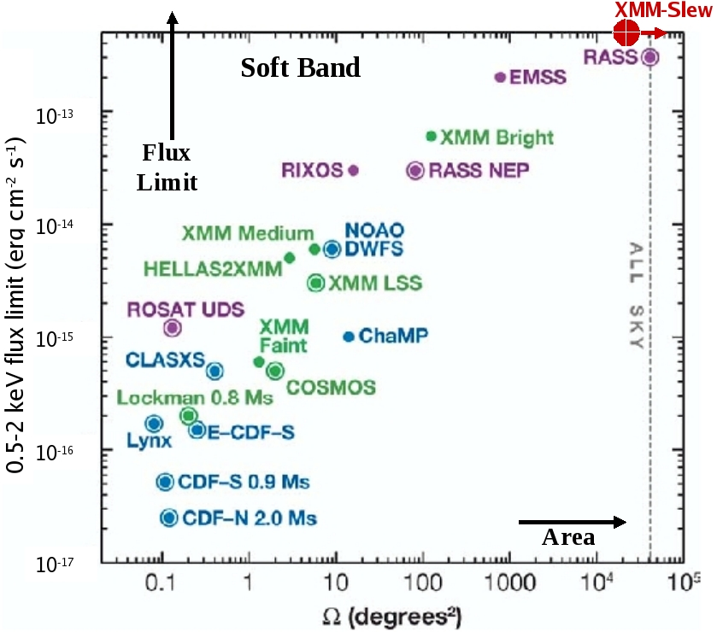
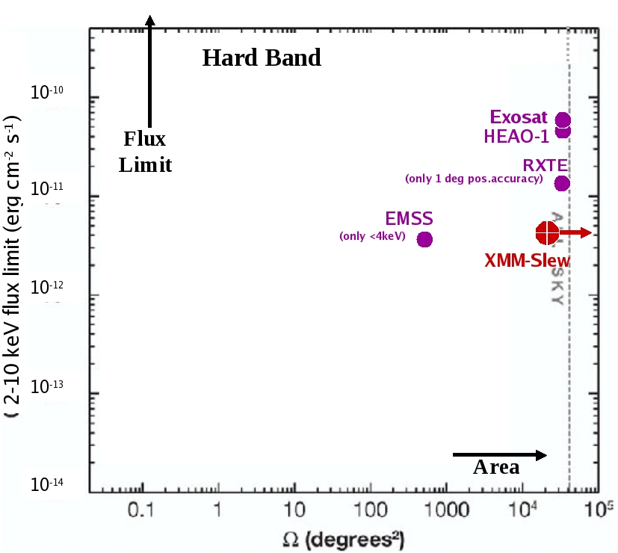
Survey area v Sensitivity
0.2 – 2 keV
2 – 10 keV

Slide 13
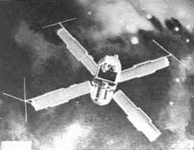
X-ray surveys
Medium energy band (2-10 keV)
UHURU

Slide 14
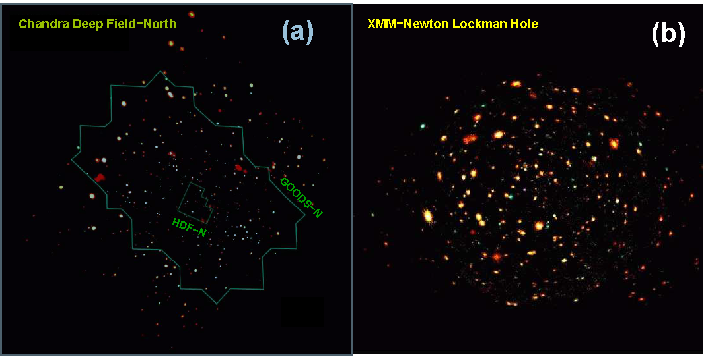
Cosmic X-ray background (CXB)
Asca and Beppo-Sax resolved ~30%
Einstein Medium Sensitivity Survey resolved ~25%
ROSAT resolved ~75% of the soft X-ray emission into AGNs
Chandra and XMM increased this to 80 – 90 %
Brandt & Hasinger 2004

Slide 15
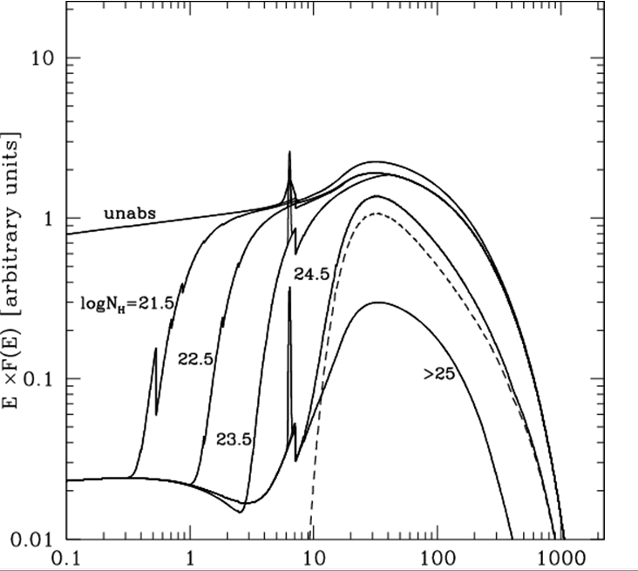
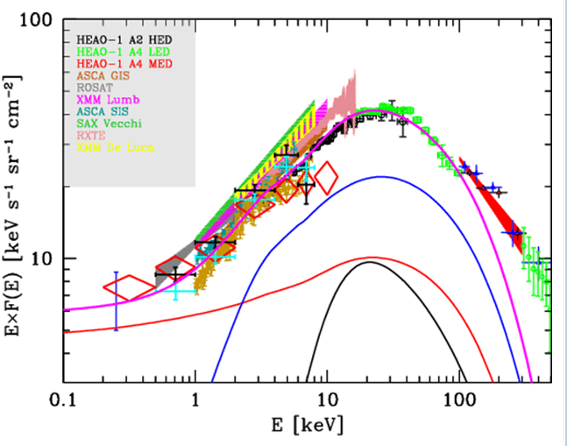
Constraints on the AGN population
Gilli et al. 2007
Absorbed
Compton-thick
Unabsorbed
At soft X-ray energies the sky is dominated by unobscured AGN but at higher energies
the contribution from the more numerous self-absorbed AGN becomes increasingly
important. Originally predicted by Setti and Woltjer 1989, now synthesis models fitting
the CXB can be used to constrain the evolution of AGN and predict a significant
fraction of highly absorbed (Compton-thick) AGN.

Slide 16
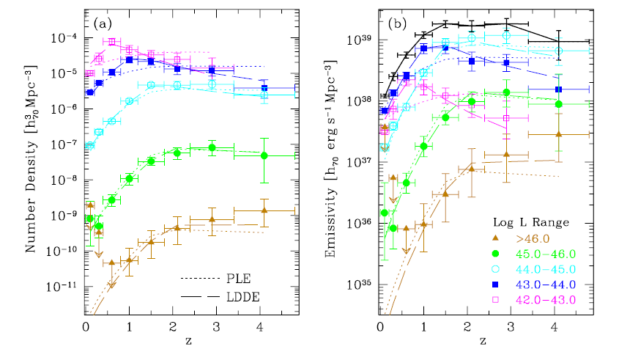
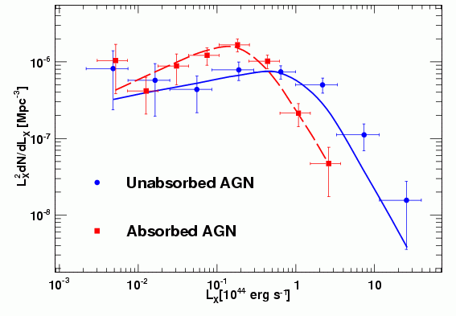
Constraints on the AGN population
L_{X}
₁₀⁴²⁻⁴³
₁₀⁴³⁻⁴⁴
₁₀⁴⁴⁻⁴⁵
₁₀⁴⁵⁻⁴⁶
_{>10}⁴⁶
Hasinger et al. 2005, La Franca et al. 2005
In detail, to model the CXB as a population of AGN the luminosity of AGN has to
evolve over cosmic time. This is seen - highly luminous QSO peak at a
redshift of 2-3 whereas the lower luminosity objects are more numerous at z<1.
Similarly, the absorbed-AGN density peaks at lower luminosities than the
unabsorbed types. Type II QSO really are rare objects.

Slide 17
CXB at high energies
Gilli et al. 2007
Absorbed
Compton-thick
Unabsorbed
Need a significant Compton-thick population to provide sufficient flux
above 10 keV.
Notes:
Prediction is 30% of all AGN are CT – Worseley et al. 2005

Slide 18
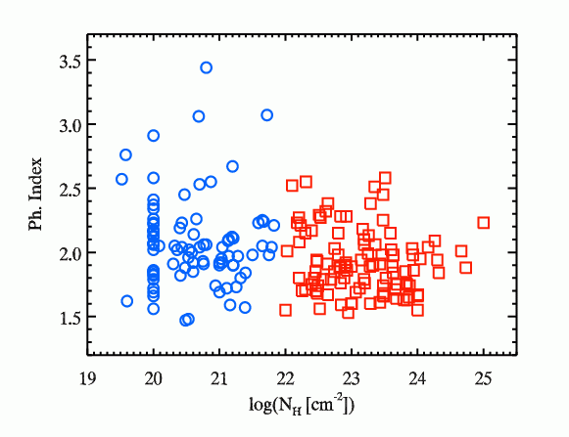
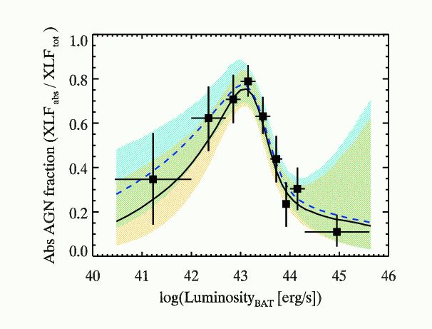
Search for Compton-Thick
(NH>10²⁴ cm⁻²) AGN
Burlon et al. 2011
SWIFT-BAT, all-sky survey of AGN, at 15-55 keV reduces the bias against highly absorbed AGN and finds 4.6% of AGN are Compton-thick (but after correcting for remaining biases this could be ~20%). Remaining fraction may be directly seen by NuSTAR and/or HXMT.
Notes:
300 AGN in BAT 3 year survey over full sky. Many CT QSO appear to be merging systems.

Slide 19
Rare Objects
Apart from counting large numbers of sources to investigate the general properties
of a class of sources, wide-area surveys are also good at finding rare classes of objects
Tidal Disruption Events
Novae
Ultra-Luminous X-ray sources (ULX)
…..

Slide 20
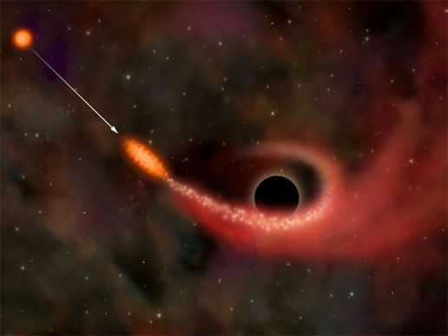
Tidal Disruption of a Star by a nuclear Massive
Black Hole
If a star gets very close to a Super-Massive Black Hole, it may be spun-up and disrupted. The debris will form a disk which can fuel the BH as a very bright X-ray source for months to years. A large fraction of the star can eventually be swallowed by BH.
Very rare event – we predict such an event every 100,000 years (in a MilkyWay-like galaxy)
The observational characteristics are:
One single, low-X-ray temperature (40- 100eV), giant X-ray burst
Coincident with the centre of an otherwise inactive galaxy (i.e. not an AGN)
Highly luminous at peak
Lasts a few weeks at peak brightness and then fades (theory predicts decline as t^{-5/3})

Slide 21
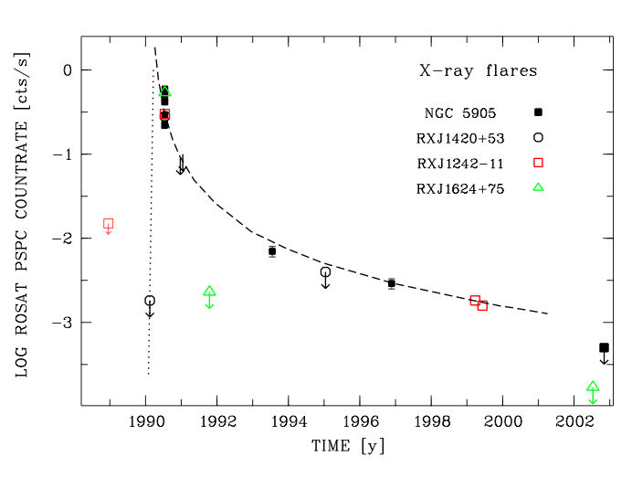

Initial Discoveries with ROSAT
4 candidates in ROSAT All-Sky Survey
L_{X} = 10⁴²-10⁴⁴ ergs/s
T_{BB} = (6-12) x 10⁵ K
Inactive galaxy hosts
Sparsely sampled light curve
A = A0 t^{-5/3}
(more or less)
Komossa 2004
No sign of a persistent AGN
Each consistent with material which continues to be consumed at a low level even 10 years after the
event
Notes:
Finally: Little detail in the ROSAT light curves or spectra. Need to catch them at peak and monitor well.

Slide 22

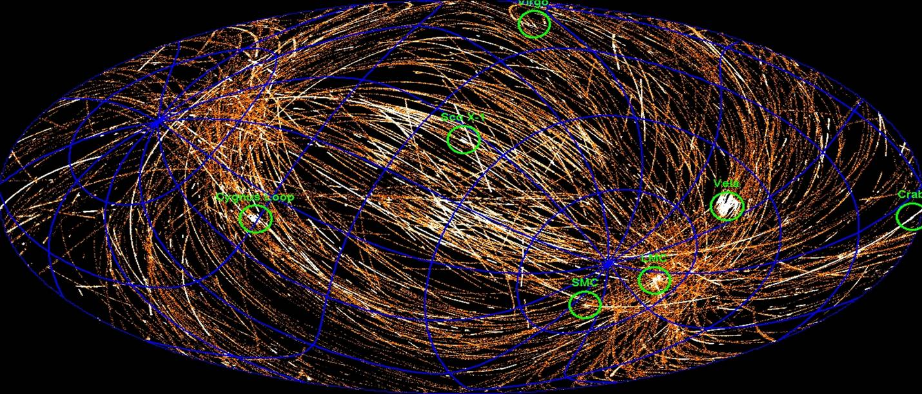
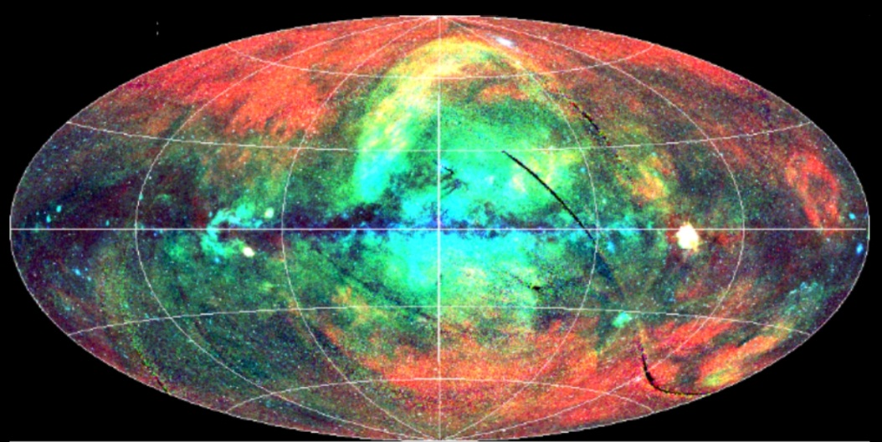
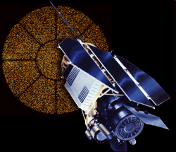
Searching for flares
4000 deg² / year
Currently covered 60% of sky.
F_{0.2-2}>6x10⁻¹³ cgs
F₂₋₁₀>4x10⁻¹² cgs
XMM
Slew survey
Source search
and compare with ROSAT…..
Full sky in 1990 / F_{0.2-2}>3x10⁻¹³ cgs
25% of sky from 1990-1998

Slide 23
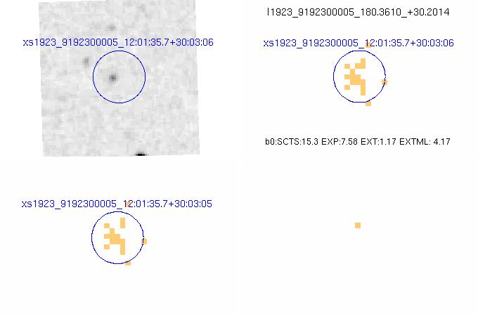
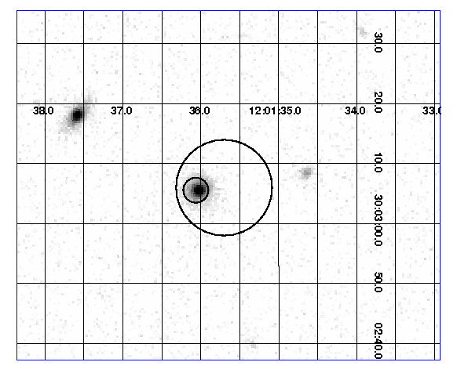
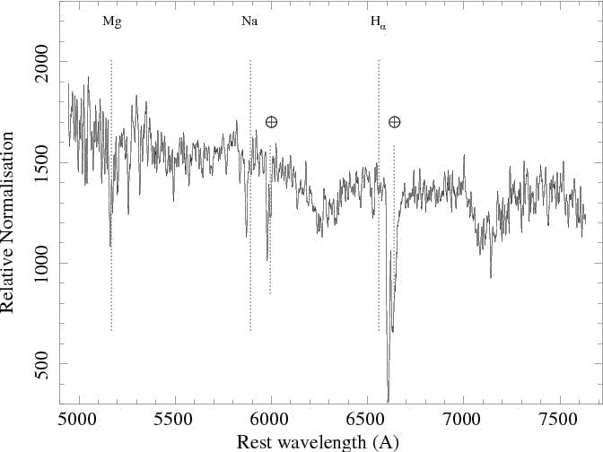
SDSS J120136+300305: discovered 10th June 2010
Bright slew source in a SDSS galaxy (19 photons)
56x brighter than ROSAT upper limit.
Soft X-ray spectrum
Optical spectrum shows no emission lines (L_{bol}<3x10⁴¹ ergs/s)
L_{x}=3x10⁴⁴ ergs/s (z=0.146)
Optical - DSS
Slew – X-ray image
Swift-UVOT position refinement
Calar-Alto – June 22 2010

Slide 24
SDSS J120136+300305: properties
= t^{-5/3}
XMM-Newton spectrum 22nd June 2010
Saxton et al. 2012
Soft X-ray spectrum, fit with single Brem of 390 eV or bkn power-law.
NOT optically-thick multi-coloured black-body or AGN-like spectrum
Monitoring started 10 days after the XMM slew, every week by SWIFT and
a long-look initially and then again after six months by XMM-Newton.
The distribution and evolution of the debris around the BH is still not understood

Slide 25
Rare Objects
Apart from counting large numbers of sources to investigate the general properties
Of a class of sources, wide-area surveys are also good at finding rare classes of objects
Tidal Disruption Events
Novae
Ultra-Luminous X-ray sources (ULX)
…..

Slide 26
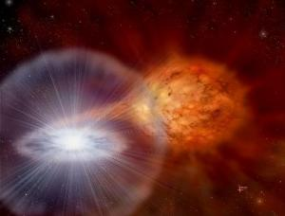
Novae
Close binary star system
WD + large companion
Matter streams from companion into disk orbit around WD
Large burst of X-ray and optical light can occur when enough matter builds up from the disk onto the White Dwarf surface to trigger the nova explosion.

Slide 27
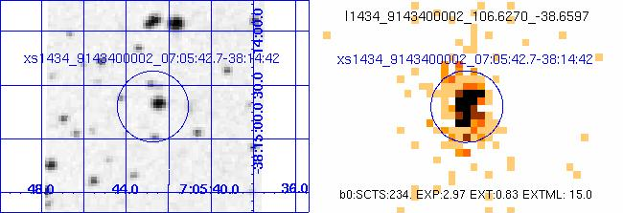
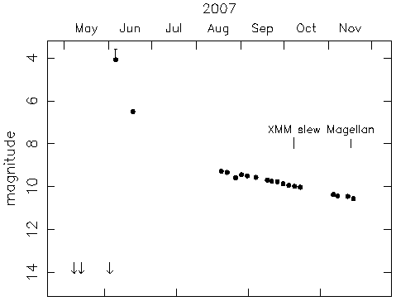
V598 Pup – New Nova XMMSL1 J070542.7-381442
Source caught in the slew as very X-ray bright (750 x RASS) in Oct 2007 – extremely soft.
Magellan spectrum showed it to be a nova.
Earlier, in June 2007, the source flared optically extremely bright – to naked eye visibility – ~brightest nova for 10 years - but no-one saw it!
Timeline of optical source obtained from All-Sky Automated Survey (ASAS) robotic telescopes (actually saturated at peak)
(Read et al, 2008)

Slide 28
Rare Objects
Apart from counting large numbers of sources to investigate the general properties
Of a class of sources, wide-area surveys are also good at finding rare classes of objects
Tidal Disruption Events
Novae
Ultra-Luminous X-ray sources (ULX)
…..

Slide 29
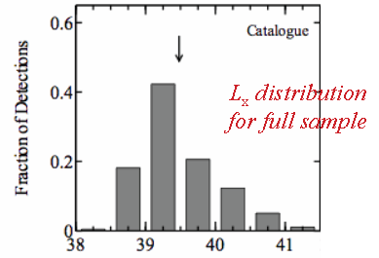
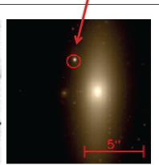
Ultra-luminous X-ray sources (ULX)
Open question about how to get from stellar BH to SMBH. Intermediate Mass BH (10²⁻⁵ M☼) should exist. Search by looking for X-ray sources in the outskirts of galaxies with L_{X}=10⁴⁰⁻⁴³ erg /s M_{BH}= 10²⁻⁵ M☼ for Eddington-limited accretion.
XMM serendipitous survey a good resource for this search (2% of sky,
250,000 objects) . Walton, Roberts, Mateos & Heard, 2011 found 45 candidate
ULX in the 2XMM catalogue with L_{X} > 2x10⁴⁰ erg /s
470 candidate detections from 2XMM catalogue.
20% contamination from background AGN

Slide 30
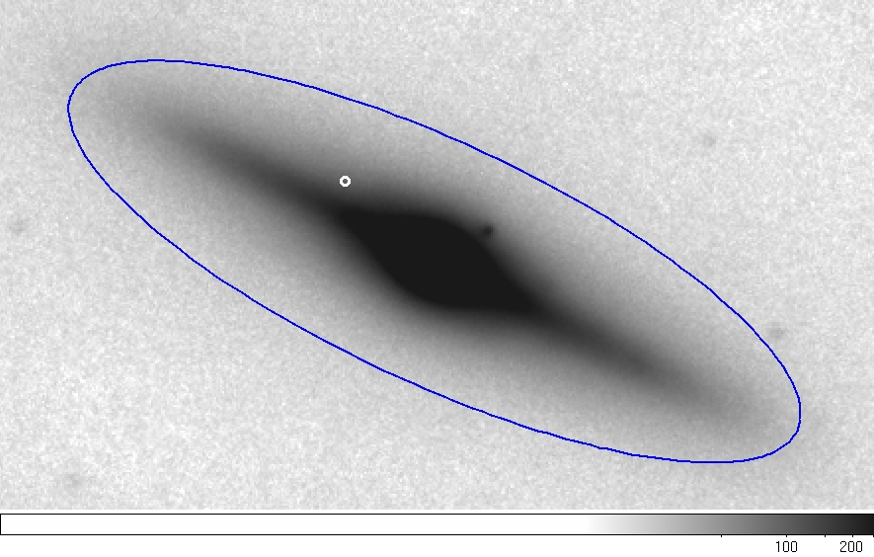
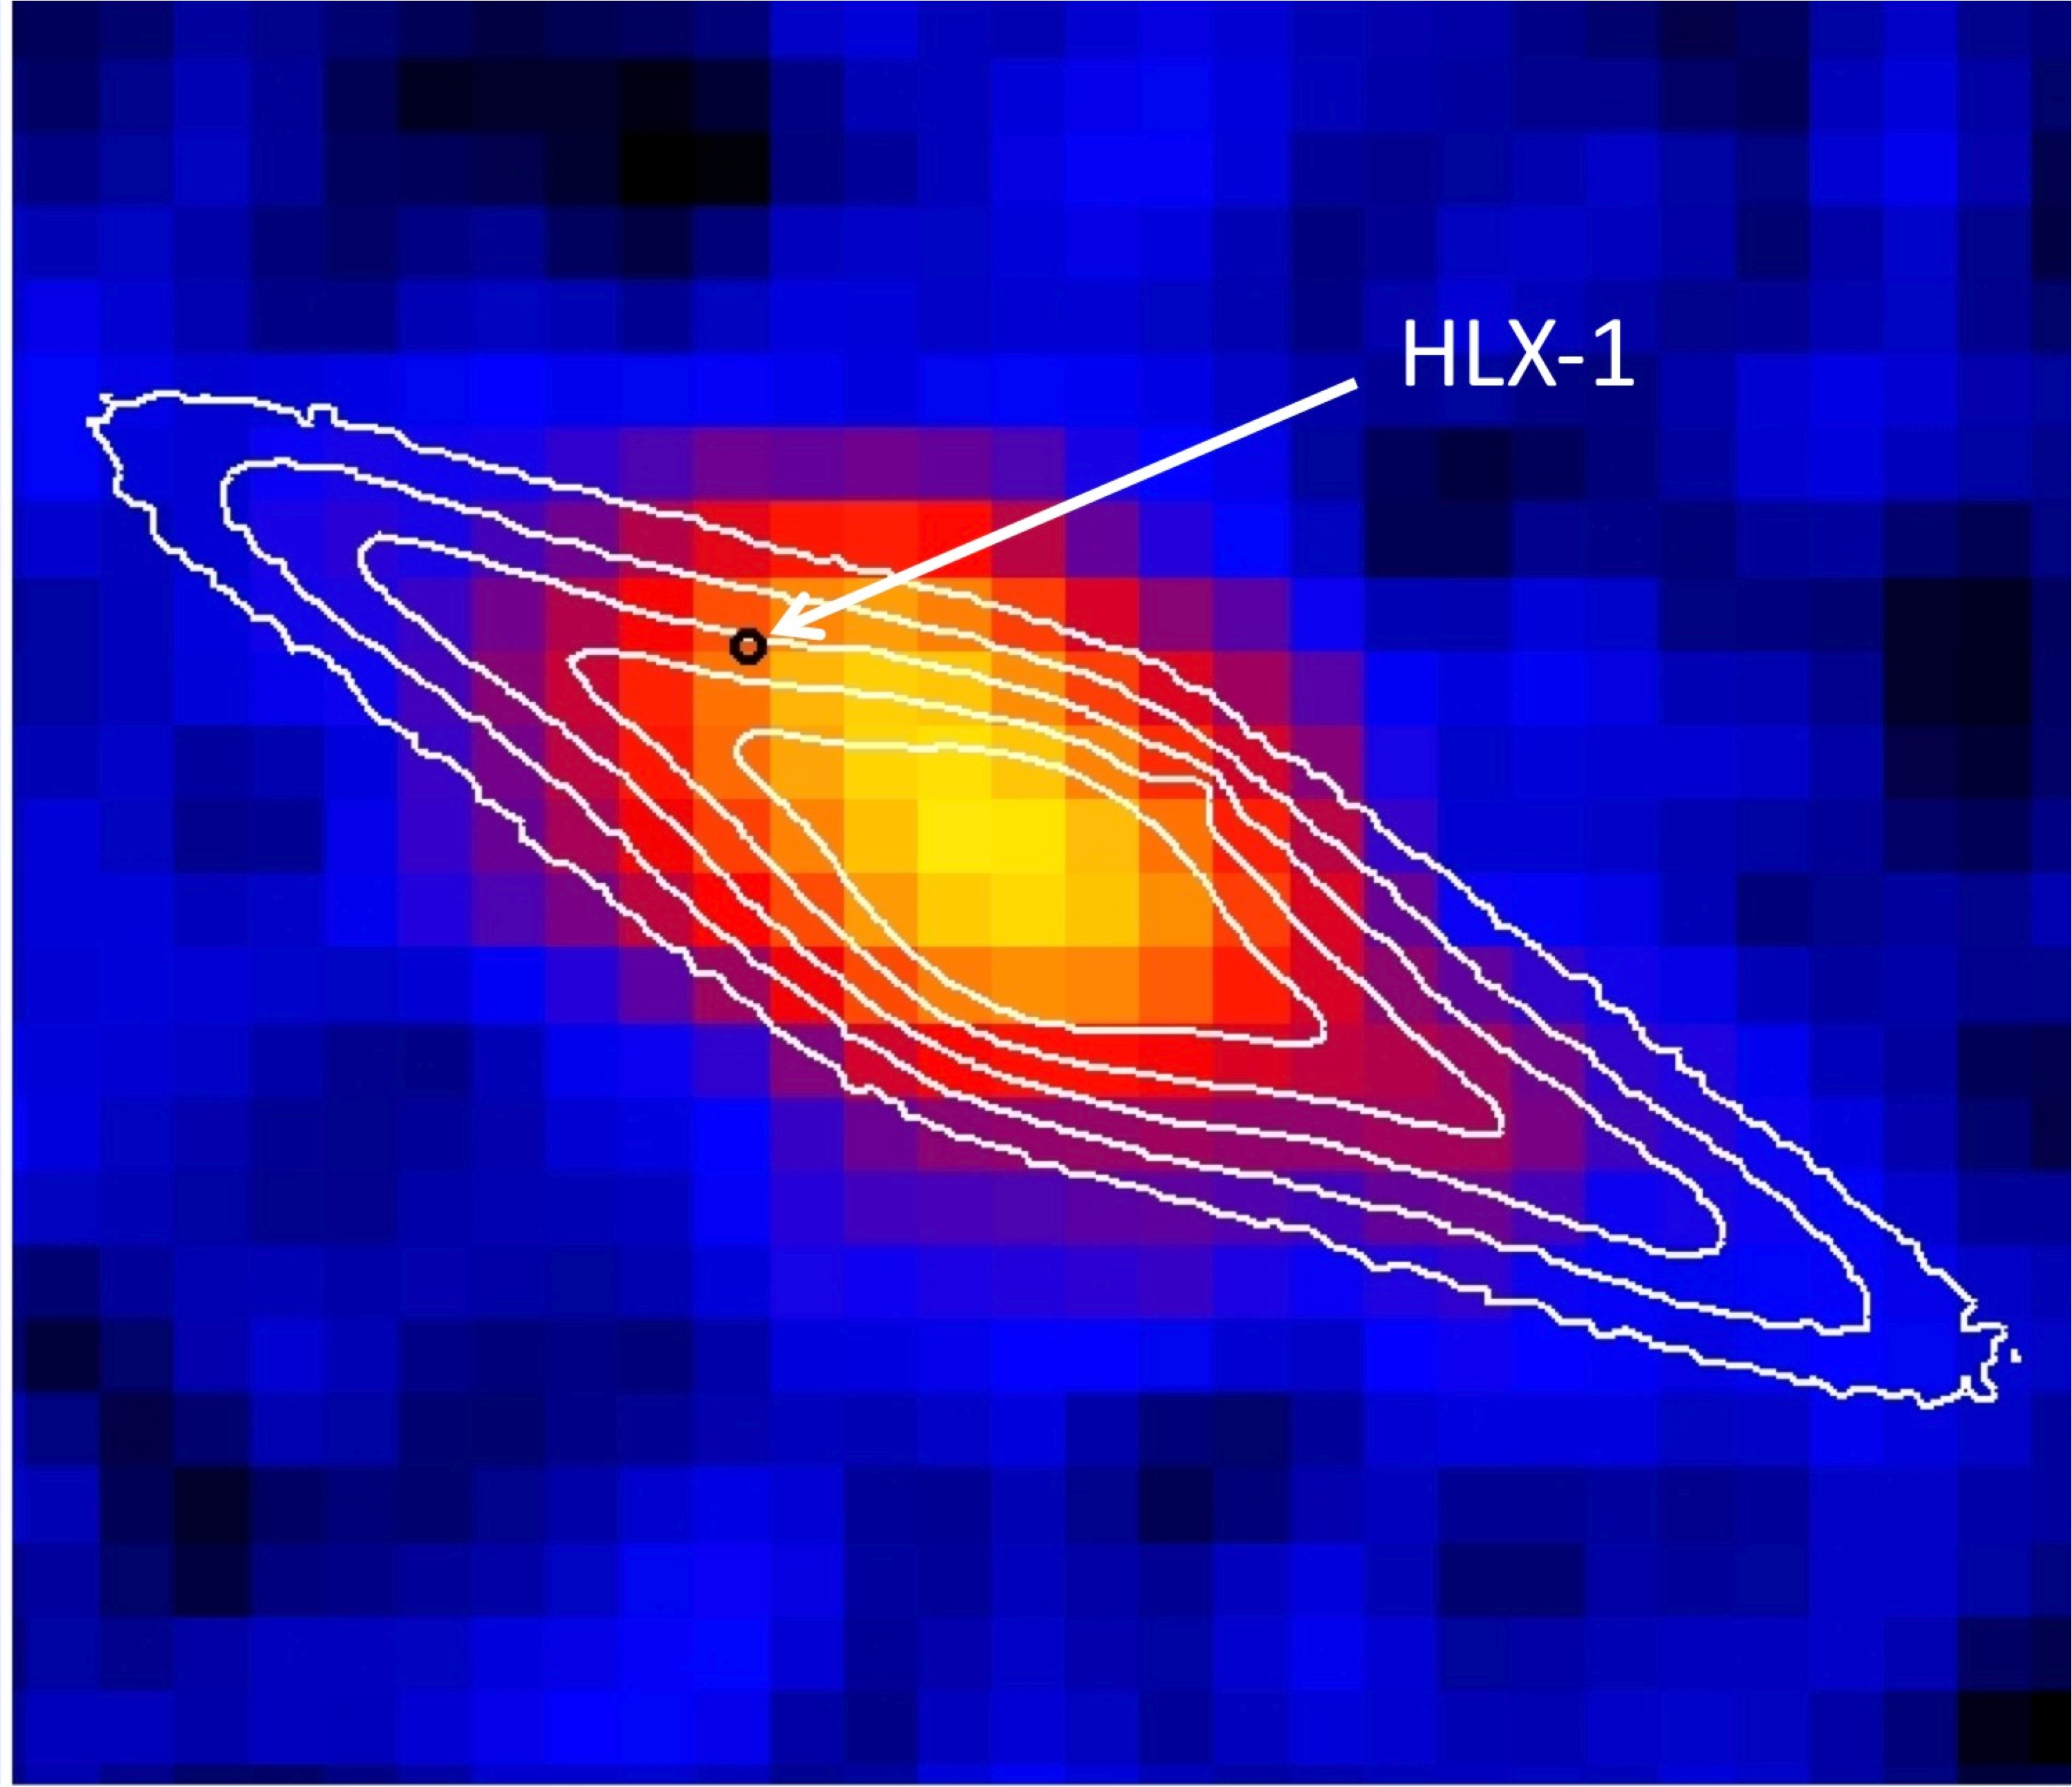
Most extreme ULX
HLX-1 detected in 2004 in field of cluster A2877 in outskirts of galaxy ESO 243-49 with Lx=10⁴² ergs/s in the high state – Farrell et al. Nature, 2009.
Best bet so far for IMBH
Chandra position of HLX-1, error ~ 0.3”
Magellan J-band image of ESO 243-49
GALEX far-UV

Slide 31
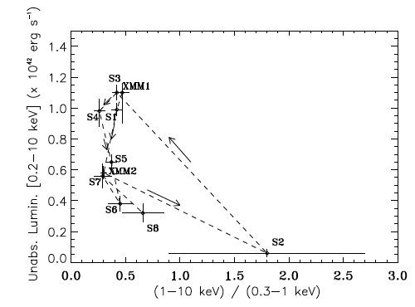
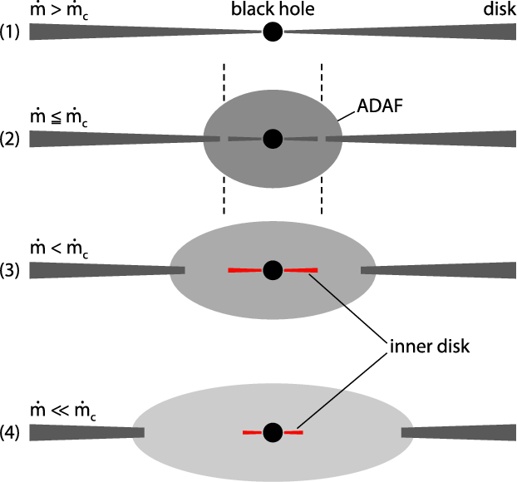
Swift monitoring of HLX-1
Very high
High/hard
Galactic black hole
X-ray binary spectral
hysteresis curve
High/soft
Low/hard
Godet, Barret, Webb, Farrell, Gehrels, 2009, ApJ, 705, L109
Hardness intensity diagram showing spectral hysteresis
Meyer-Hofmeister et al. 2009

Slide 32
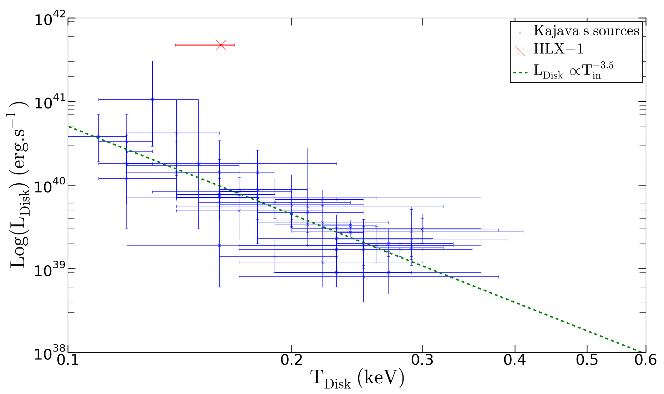
HLX-1 Luminosity v Temperature
Blue points from Kajava & Poutanen (2009)
L v T relationship compared with Galactic binaries indicates the same process
but with a higher mass – current interpretation is an accreting binary with
M_{BH} = 500 – 1500 M☼

Slide 33
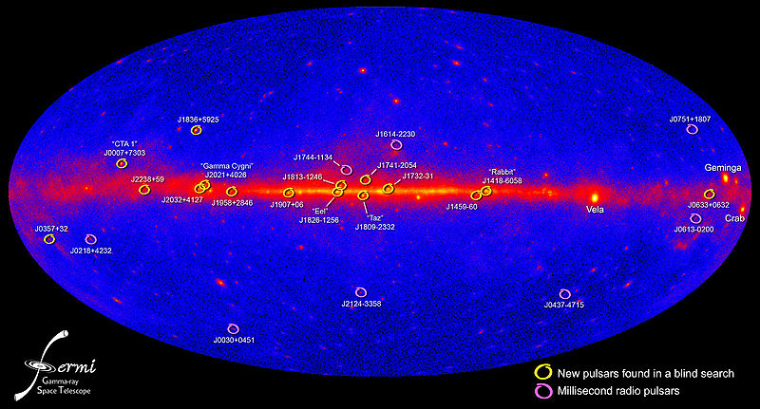
Higher energies
High energy sky - >200 MeV dominated by pulsars and blazars
Fermi LAT 2nd AGN Catalogue - Ackermann et al . 2011 - 886 sources from
200 MeV – 300 GeV. 395 BL Lacs, 310 flat-spectrum radio quasars (FSRQ),
157 other blazars, 14 AGN.
Can probe blazar parameter space not accessible at other wavelengths

Slide 34
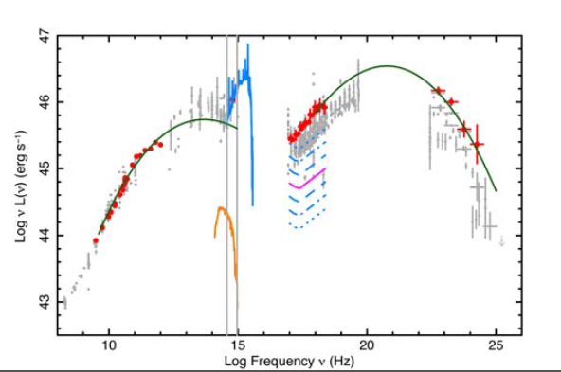
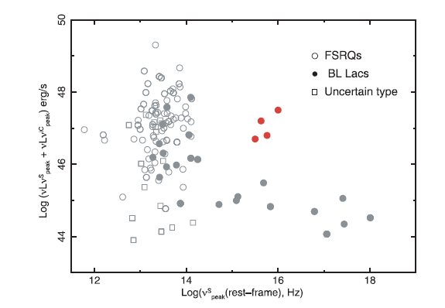
Fermi - Blazars
Redshift contraints available for 103 blazars from 2LAC catalogue (Ackermann et al. 2011)
Padovani, Giommi & Rau, 2012 followed up 11 with z>1. By observing simultaneously with
GROND and SWIFT they found 4 , so far very rare, High Synchrotron peak blazars
with high luminosity.
BL Lac SED - Giommi et al. 2012
Padovani, Giommi & Rau, 2012
Notes:
New wavebands give the opportunity to explore the full range of parameter space andfind the true intrinsic population of the blazar properties.

Slide 35
What does the future hold?
eRosita – 20-40x deeper than ROSAT, 1.8 million AGN, 100,000 clusters of galaxies, 1 tidal disruption event per week !
NuSTAR – imaging at 30 keV
HXMT - all-sky survey at 1-250 keV

Slide 36
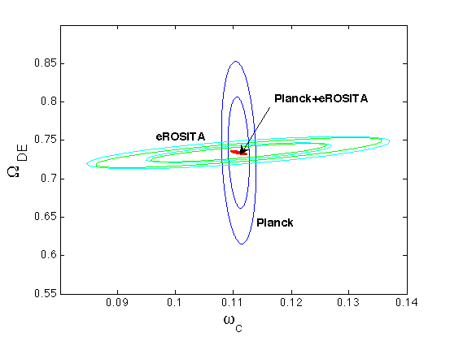
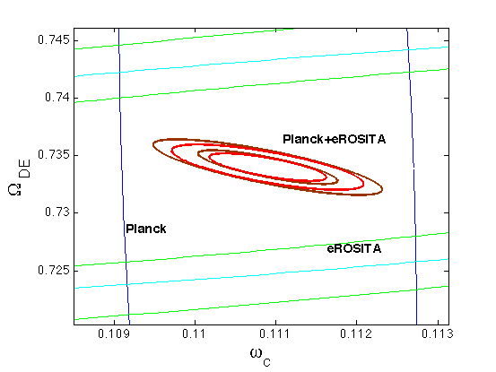
eRosita : Clusters of Galaxies
First detection of Virgo in 1966 - Byram, Chubb & Freidman 1966
Uhuru : 52 - Forman et al. 1978
Einstein – EMSS - 99 - Stocke et al. 1991
Rosat –RASS + pointed : ~4000 (many surveys, e.g. MACS - Ebeling, Edge, & Henry 2001)
eRosita : 100,000
With 100,00 clusters, tight constraints can be put on cosmological and dark energy parameters:
Majumdar et al. 2011

Slide 37
X-ray surveys
Physics of hot temperatures
Etc…..

Slide 38
Data Archiving and Mining
What we archive:
- Positions
- Photometry
- image, spectral and light-curve products
- source extent
- identification and source category (where known)
What we do not archive
- spectral parameters, line strengths, positions etc.
- temporal info, period, % variability…
What should we archive ?

Slide 39
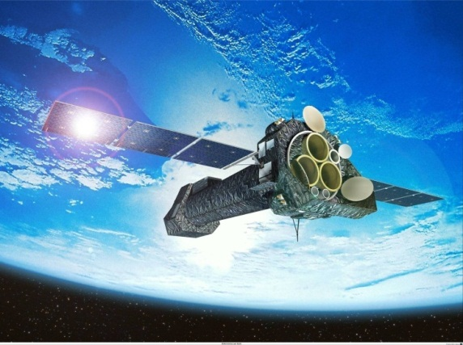
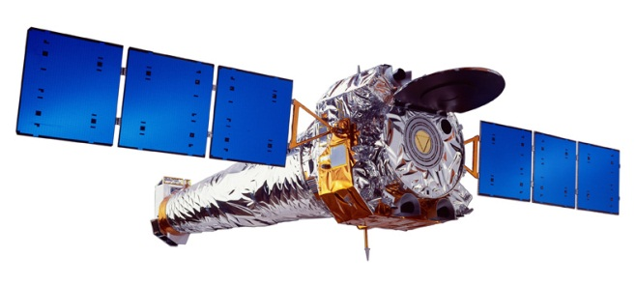
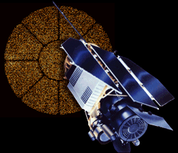
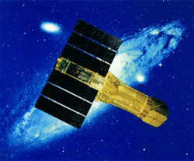
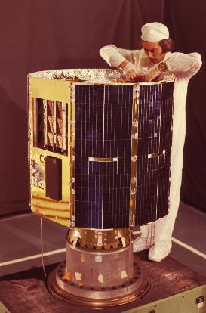






Chandra
XMM-Newton
ROSAT
THE END – THANK YOU
ASCA
ARIEL-V
SAX
EINSTEIN
FERMI
UHURU
INTEGRAL
HEAO-1
Swift

